Slide 1
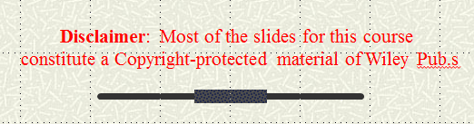
MSiA 422 – Introduction to Java and Python Programming
Winter 2017
Anan Yaagoub
PhD - Northwestern University - Computer Science Department
1

Slide 2

OOP - Java
Java is an Object-Oriented Language. As a language that has the Object Oriented feature, Java supports the following fundamental concepts:
  Polymorphism
  Inheritance
  Encapsulation
  Abstraction
  Classes
  Objects
  Instance
  Method

Slide 3

Objects/Class
Object - Objects have states and behaviors. Example: A dog has states - color, name, breed as well as behaviors -wagging, barking, eating. An object is an instance of a class.
  CAR
  Circle
  Student
Class - A class can be defined as a template/blue print that describes the behaviors/states that object of its type support.

Slide 4

Object-Oriented Programming
You have learned structured programming
  Breaking tasks into subtasks
  Writing re-usable methods to handle tasks
We will now study Objects and Classes
  To build larger and more complex programs
  To model objects we use in the world
A class describes objects with the same behavior. For example, a Car class describes all passenger vehicles that have a certain capacity and shape.

Slide 5
Source File Rules
There can be only one public class per source file.
A source file can have multiple non public classes.
The public class name should be the name of the source file as well which should be appended by .java at the end.
If the class is defined inside a package, then the package statement should be the first statement in the source file.
If import statements are present then they must be written between the package statement and the class declaration. If there are no package statements then the import statement should be the first line in the source file.
Classes have several access levels and there are different types of classes; abstract classes, final classes, etc. we will be explaining about all these in the access modifiers chapter.

Slide 6
Objects and Programs
Java programs are made of objects that interact with each other
  Each object is based on a class
  A class describes a set of objects with the same behavior
Each class defines a specific set of methods to use with its objects
  For example, the String class provides methods:
    Examples: length() and charAt() methods
String greeting = “Hello World”;
int len = greeting.length();
char c1 = greeting.charAt(0);

Slide 7
Diagram of a Class
Private Data
  Each object has its own private data that other objects cannot directly access
  Methods of the public interface provide access to private data, while hiding implementation details:
  This is called Encapsulation
Public Interface
  Each object has a set of methods available for other objects to use
Class
Private Data
(Variables)
Public Interface
(Methods)

Slide 8

Implementing a Simple Class
Example: Cash Register: A class that models a cash register that is used to calculate a sale priced items.
  For example, to find out what is the total sale
What should it do?
  Increment the items count/total
  Get the current count/total

Slide 9
Cash Register Class
Specify instance variables in the class declaration:
Each object instantiated from the class has its own set of instance variables
  Each tally counter has its own current count
Access Specifiers:
  Classes (and interface methods) are public
  Instance variables are always private
Public class Cashregister
{
  Private int itemCount;
  Private double totalPrice;
  . . .
}

Slide 10

Instantiating Objects
Objects are created based on classes
  Use the new operator to construct objects
  Give each object a unique name (like variables)
You have used the new operator before:
Creating an instances of Cash Register:
Scanner in = new Scanner(System.in);
Class name
Object name
Class name
CashRegister reg1 = new CashRegister();
Use the new operator to construct objects of a class.

Slide 11
Public Interface of a Class
When you design a class, start by specifying the public interface of the new class
  Example: A Cash Register Class
    What tasks will this class perform?
    What methods will you need?
    What parameters will the methods need to receive?
    What will the methods return?
Task | Method | Returns
Add the price of an item | addItem(double) | void
Get the total amount owed | getTotal() | double
Get the count of items purchased | getCount() | int
Clear the cash register for a new sale | clear() | void

Slide 12
Writing the Public Interface
/**
A simulated cash register that tracks the item count
and the total amount due.
*/
public class CashRegister
{
/**
Adds an item to this cash register.
@param price: the price of this item
*/
public void addItem(double price)
{
// Method body
}
/**
Gets the price of all items in the current sale.
@return the total price
*/
public double getTotal() ...
Javadoc style comments document the class and the behavior of each method
The method declarations make up the public interface of the class
The data and method bodies make up the private implementation of the class

Slide 13
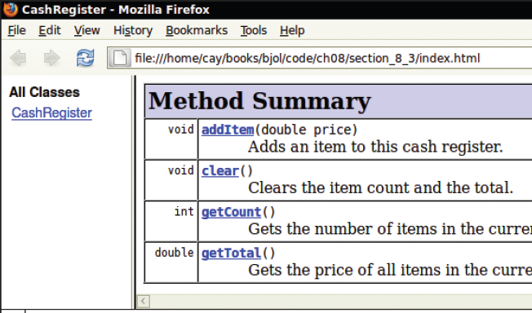
Javadoc
The Javadoc utility generates a set of HTML files from the Javadoc style comments in your source code
  Methods document parameters and returns:
    @param
    @return

Slide 14
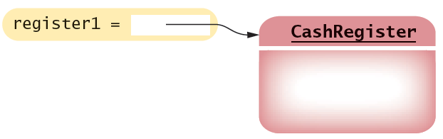

Non-static Methods Means…
We have been writing class methods using the static modifier:
For non-static (instance) methods, you must instantiate an object of the class before you can invoke methods
  Then invoke methods of the object
public static void addItem(double val)
public void addItem(double val)
public static void main(String[] args)
{
// Construct a CashRegister object
CashRegister register1 = new CashRegister();
// Invoke a non-static method of the object
register1.addItem(1.95);
}

Slide 15
Accessor and Mutator Methods
Many methods fall into two categories:
  1) Accessor Methods: 'get' methods
    Asks the object for information without changing it
    Normally return a value of some type
  2) Mutator Methods: 'set' methods
    Changes values in the object
    Usually take a parameter that will change an instance variable
    Normally return void
public double getTotal() { }
public int getCount() { }
public void addItem(double price) { }
public void clear() { }

Slide 16
Designing the Data Representation
An object stores data in instance variables
  Variables declared inside the class
  All methods inside the class have access to them
    Can change or access them
  What data will our CashRegister methods need?
Task | Method | Data Needed
Add the price of an item | addItem() | total, count
Get the total amount owed | getTotal() | total
Get the count of items purchased | getCount() | count
Clear the cash register for a new sale | clear() | total, count
An object holds instance variables that are accessed by methods

Slide 17

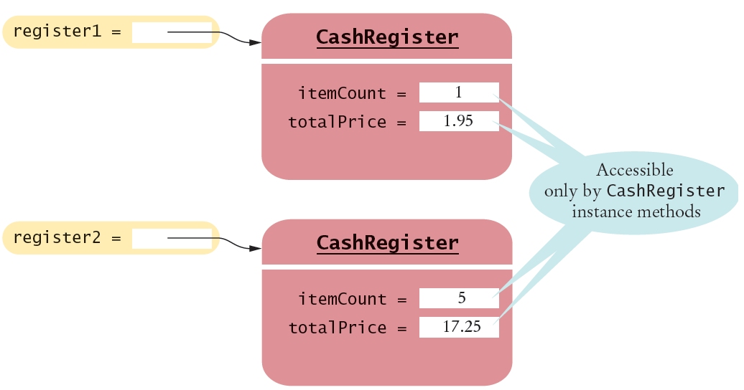
Instance Variables of Objects
Each object of a class has a separate set of instance variables.
The values stored in instance variables make up the state of the object.

Slide 18
Implementing Instance Methods
Implement instance methods that will use the private instance variables
public void addItem(double price)
{
itemCount++;
totalPrice = totalPrice + price;
}
Task | Method | Returns
Add the price of an item | addItem(double) | void
Get the total amount owed | getTotal() | double
Get the count of items purchased | getCount() | int
Clear the cash register for a new sale | clear() | void

Slide 19
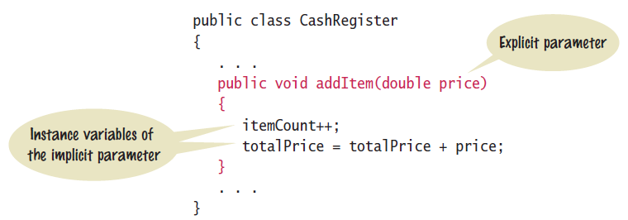
Syntax: Instance Methods
Use instance variables inside methods of the class
  There is no need to specify the implicit parameter (name of the object) when using instance variables inside the class
  Explicit parameters must be listed in the method declaration

Slide 20
Constructors
A constructor is a method that initializes instance variables of an object
  It is automatically called when an object is created
  It has exactly the same name as the class
public class CashRegister
{
. . .
/**
Constructs a cash register with cleared item count and total.
*/
public CashRegister() // A constructor
{
itemCount = 0;
totalPrice = 0;
}
}
Constructors never return values, but do not use void in their declaration

Slide 21
Multiple Constructors
A class can have more than one constructor
  Each must have a unique set of parameters
public class BankAccount
{
. . .
/**
Constructs a bank account with a zero balance.
*/
public BankAccount( ) { . . . }
/**
Constructs a bank account with a given balance.
@param initialBalance the initial balance
*/
public BankAccount(double initialBalance) { . . . }
}
The compiler picks the constructor that matches the construction parameters.
BankAccount joesAccount = new BankAccount();
BankAccount lisasAccount = new BankAccount(499.95);

Slide 22
The Default Constructor
If you do not supply any constructors, the compiler will make a default constructor automatically
  It takes no parameters
  It initializes all instance variables
public class CashRegister
{
. . .
/**
Does exactly what a compiler generated constructor would do.
*/
public CashRegister()
{
itemCount = 0;
totalPrice = 0;
}
}
By default, numbers are initialized to 0, booleans to false, and objects as null.

Slide 23
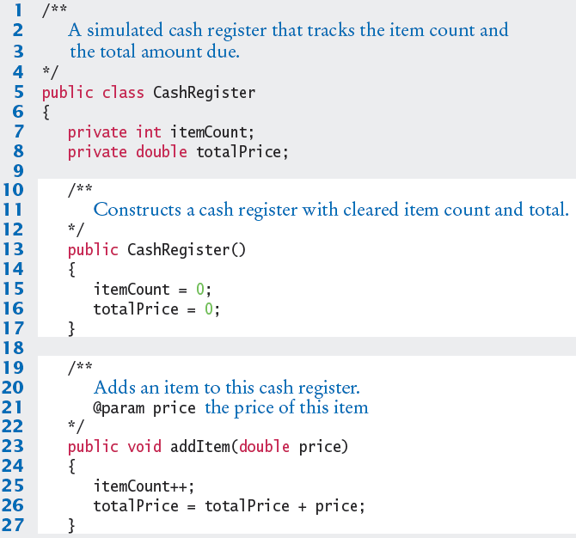
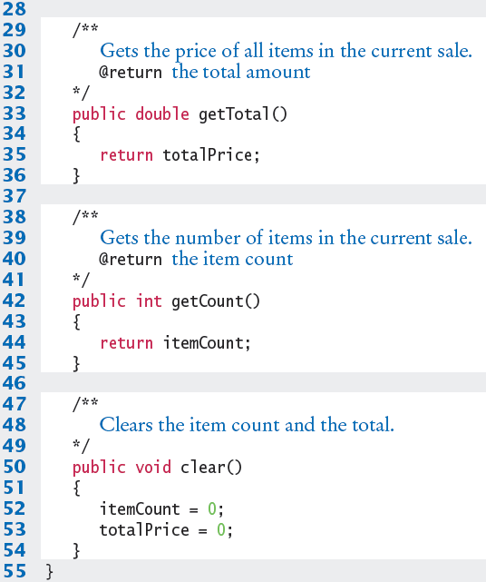
CashRegister.java

Slide 24

Common Error
Declaring a Constructor as void
  Constructors have no return type
  This creates a method with a return type of void which is NOT a constructor!
    The Java compiler does not consider this an error
public class BankAccount
{
/**
Intended to be a constructor.
*/
public void BankAccount( )
{
. . .
}
}
Not a constructor…. Just another method that returns nothing (void)

Slide 25

Special Topic
Overloading
  We have seen that multiple constructors can have exactly the same name
    They require different lists of parameters
  Actually any method can be overloaded
    Same method name with different parameters
  We will not be using overloading in this book
    Except as required for constructors
void print(CashRegister register) { . . . }
void print(BankAccount account) { . . . }
void print(int value) { . . . }
Void print(double value) { . . . }

Slide 26
Testing a Class
We wrote a CashRegister class but…
  You cannot execute the class – it has no main method
It can become part of a larger program
  Test it first though with unit testing
To test a new class, you can use:
  Programming tools that interactively create objects:
    DrJava: www.drjava.org
    BlueJ: www.bluej.org
  Or write a tester class:
    With a main
public class CashRegisterTester
{
public static void main(String[] args)
{
CashRegister c1 = new CashRegister();
...

Slide 27
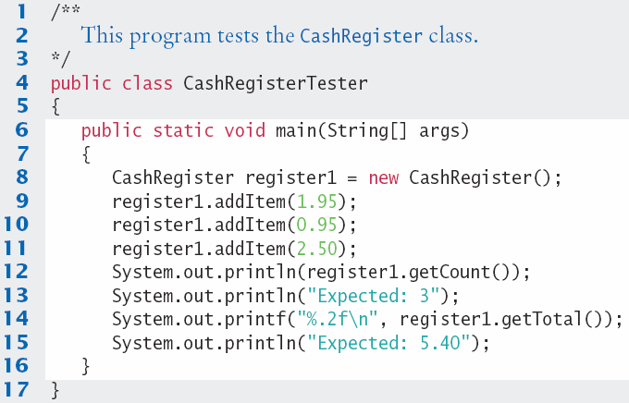
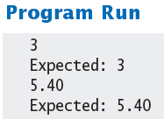
CashRegisterTester.java
Test all methods
  Print expected results
  Output actual results
  Compare results
A unit test verifies that a class works correctly in isolation, outside a complete program.

Slide 28

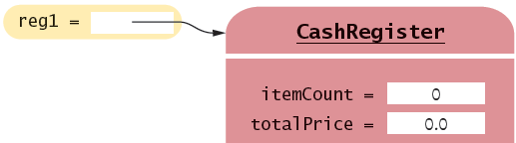
Object References
Objects are similar to arrays because they always have reference variables
  Array Reference
  Object Reference
double[] values = new double[5];
CashRegister reg1 = new CashRegister;
An object reference specifies the memory location of the object

Slide 29
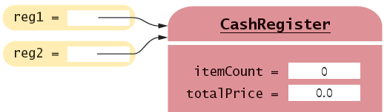
Shared References
Multiple object variables may contain references to the same object.
  Single Reference
  Shared References
CashRegister reg1 = new CashRegister;
CashRegister reg2 = reg1;
The internal values can be changed through either reference

Slide 30
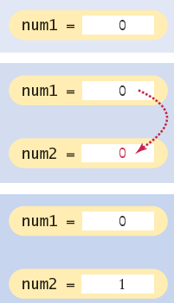
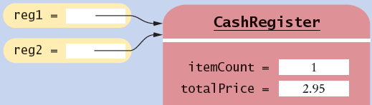
Primitive versus Reference Copy
Primitive variables can be copied, but work differently than object references
  Primitive Copy Reference Copy
    Two locations One location for both
int num1 = 0;
int num2 = num1;
num2++;
CashRegister reg1 = new CashRegister;
CashRegister reg2 = reg1;
reg2.addItem(2.95);
Why? Primitives take much less storage space than objects!

Slide 31
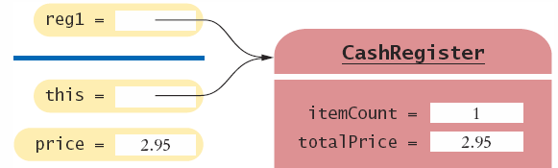
The this reference
Methods receive the ‘implicit parameter’ in a reference variable called ‘this’
  It is a reference to the object the method was invoked on:
  It can clarify when instance variables are used:
void addItem(double price)
{
this.itemCount++;
this.totalPrice = this.totalPrice + price;
}

Slide 32
Constructor this reference
Sometimes people use the this reference in constructors
  It makes it very clear that you are setting the instance variable:
public class Student
{
private int id;
private String name;
public Student(int id, String name)
{
this.id = id;
this.name = name;
}
}

Slide 33
Static Variables and Methods
Variables can be declared as static in the Class declaration
  There is one copy of a static variable that is shared among all objects of the Class
public class BankAccount
{
private double balance;
private int accountNumber;
private static int lastAssignedNumber = 1000;
public BankAccount()
{
lastAssignedNumber++;
accountNumber = lastAssignedNumber;
}
. . .
}
Methods of any object of the class can use or change the value of a static variable

Slide 34
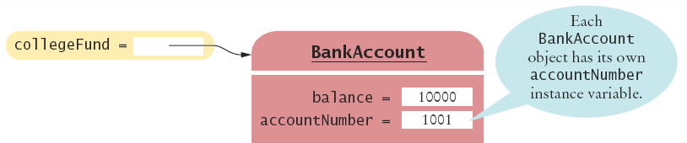
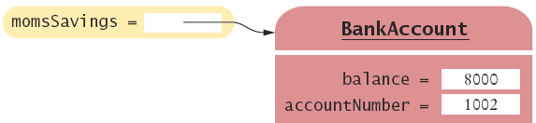
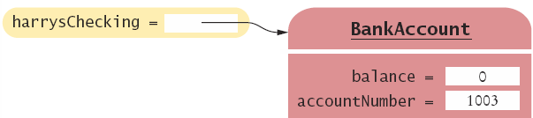
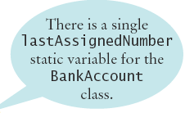
Using Static Variables
Example:
  Each time a new account is created, the lastAssignedNumber variable is incremented by the constructor
Access the static variable using:
  ClassName.variableName

Slide 35
Using Static Methods
The Java API has many classes that provide methods you can use without instantiating objects
  The Math class is an example we have used
  Math.sqrt(value) is a static method that returns the square root of a value
  You do not need to instantiate the Math class first
Access static methods using:
  ClassName.methodName()

Slide 36
Writing your own Static Methods
You can define your own static methods
public class Financial
{
/**
Computes a percentage of an amount.
@param percentage the percentage to apply
@param amount the amount to which the percentage is applied
@return the requested percentage of the amount
*/
public static double percentOf(double percentage, double amount)
{
return (percentage / 100) * amount;
}
}
static methods usually return a value. They can only access static variables and methods.
Invoke the method on the Class, not an object
double tax = Financial.percentOf(taxRate, total);

